Slide 1
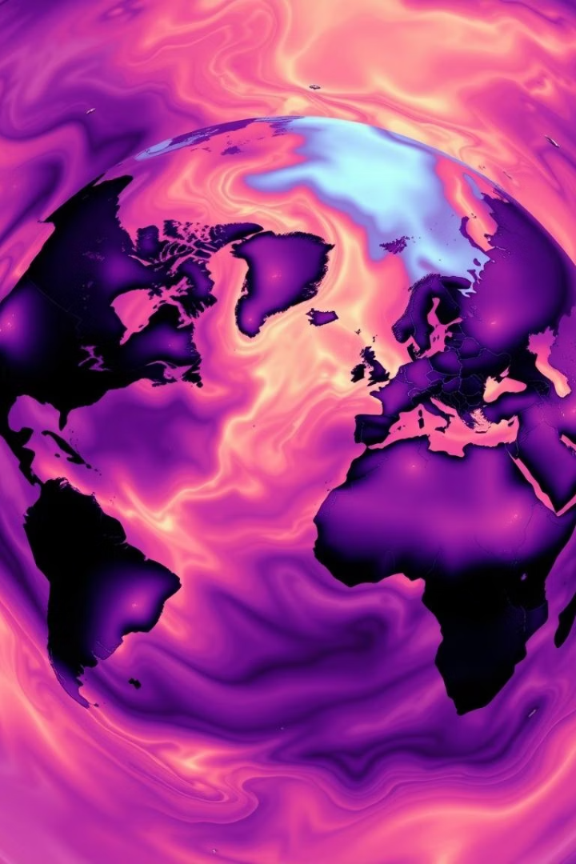
TempExtremes: Analyzing Patterns and Trends in Hot and Cold Days
Analyzing decades of temperature data to reveal trends in extreme heat and cold events.
Using climatology and machine learning to predict events and inform policies in health, energy, and agriculture.
Providing actionable insights to reduce risks and boost resilience against climate variability.

Slide 2

Project Summary & Problem Statement
Investigate rise of hot and cold day frequency and severity.
Quantify and visualize extremes over time and regions.
Assess threats to health, agriculture, energy infrastructure.
Data-driven foundation for adaptive climate strategies.
Support policy formulation for climate resilience.
Enhance predictive capabilities for future extremes.

Slide 3
Objectives & Importance
Classify extremes
Analyze frequency
Explore relationships
Establish scientific temperature thresholds to accurately identify and categorize hot and cold extreme weather events across different regions and periods.
Study the timing, duration, and recurrence patterns of extreme temperature events to uncover trends and changes over time.
Investigate how temperature extremes interact with other meteorological variables such as humidity, wind, and atmospheric pressure to understand contributing factors and impacts.
Develop prediction models
Support resilience planning
Utilize machine learning techniques to build forecasting models that can predict upcoming extreme temperature events with improved accuracy.
Provide insights and data-driven recommendations to aid urban and rural climate adaptation strategies for mitigating the effects of extreme temperatures.

Slide 4

Data Sources & Variables
Data Sources
Key Variables
Data Processing
NOAA GSOD: Global surface observations providing daily temperature and precipitation
Temperature, humidity: Key indicators of thermal conditions
Timestamps and geo-coordinates: Precise temporal and spatial referencing
Wind speed, pressure: Factors influencing weather patterns and extremes
ERA5 reanalysis data: Comprehensive atmospheric data from weather models
Data cleaning and quality checks: Ensuring reliability and accuracy
Cloud cover, elevation: Variables affecting solar radiation and temperature
Outlier detection and anomaly removal: Filtering unusual or erroneous data points
Local weather stations: Ground-truth data for specific regions and microclimates

Slide 5





Methodology Overview
Preprocessing
Clean, align, and normalize all data from multiple sources to ensure consistency and reliability before analysis.
Thresholding
Define and apply fixed and statistical temperature limits to accurately label hot and cold days in each region and timeframe.
Exploratory Analysis
Visualize seasonal and geographic trends in extreme temperature events to identify patterns and anomalies.
Modeling
Implement classification, clustering, and forecasting techniques to predict and categorize temperature extremes.
Validation
Conduct statistical tests and evaluate model accuracy using metrics to ensure robustness and predictive power.

Slide 6

Preprocessing Steps
Data collection and integration
1
Gathering raw data from multiple sources and consolidating it into a unified dataset for analysis.
2
Quality control and anomaly detection
Identifying and removing erroneous or inconsistent data to ensure accuracy.
Missing value imputation
3
Filling gaps in the dataset using statistical methods or predictive modeling to maintain completeness.
4
Feature engineering and standardization
Creating relevant features and normalizing data to improve model performance and comparability.

Slide 7





Thresholds & Classification
Composite Indices
Statistical Approach
Seasonal Adjustment
Heat Index, Wind Chill effects
Top/Bottom 5% of temperature values
Normalized by regional climate
Labeling
Fixed Thresholds
Binary flags and severity levels
3
Hot > 90°F, Cold < 32°F
2
4
1
5

Slide 8
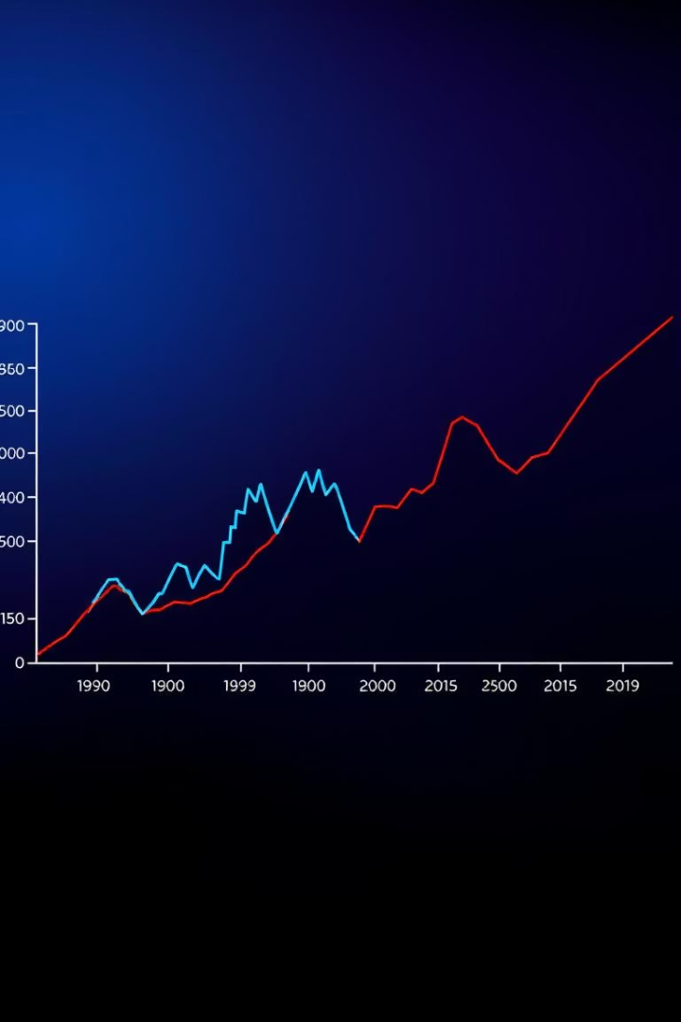




Exploratory Data Analysis
Temporal Distribution
Heat Wave and Cold Spell Duration
Analyze temporal distribution of temperature extremes to identify seasonal and long-term trends.
Examine heat wave and cold spell duration to understand persistence and potential impacts on health and infrastructure.
Geographic Patterns
Urban Heat Island Effects
Explore geographic patterns of extreme temperatures across regions to detect hotspots and climate variability.
Investigate urban heat island effects and their amplification of temperature extremes in metropolitan areas.
Visualizations
Create visualizations highlighting anomalies and unusual temperature events for clear communication of findings.

Slide 9








ML Models & Tools
Classification
Forecasting
Random Forest builds multiple trees to classify by majority vote.
ARIMA models linear time relations; LSTM handles complex sequences.
Clustering
Tools
K-Means groups by similarity; DBSCAN finds density clusters and noise.
Python for programming; Pandas for data; TensorFlow for ML models.
Visualization
Spatial
Seaborn and Matplotlib create statistical and general plots.
GeoPandas handles geospatial and vector GIS data.
Metrics
Validation
Accuracy for overall correctness; F1-score balances precision & recall.
RMSE measures forecasting prediction errors.

Slide 10
Expected Deliverables
Cleaned and enriched datasets with flags: High-quality, preprocessed data marked with relevant hot and cold day indicators for accurate analysis.
Exploratory visualizations and heatmaps: Insightful visual tools highlighting temperature patterns, trends, and geographical hotspots across regions and seasons.
ML models for prediction and clustering: Robust machine learning algorithms designed to classify temperature extremes and group similar climate events.
Interactive stakeholder dashboard: User-friendly interface enabling stakeholders to explore data, forecasts, and trends dynamically.
Comprehensive documentation and guides: Detailed instructions and explanations to support understanding and usage of datasets, models, and dashboards.

Slide 11
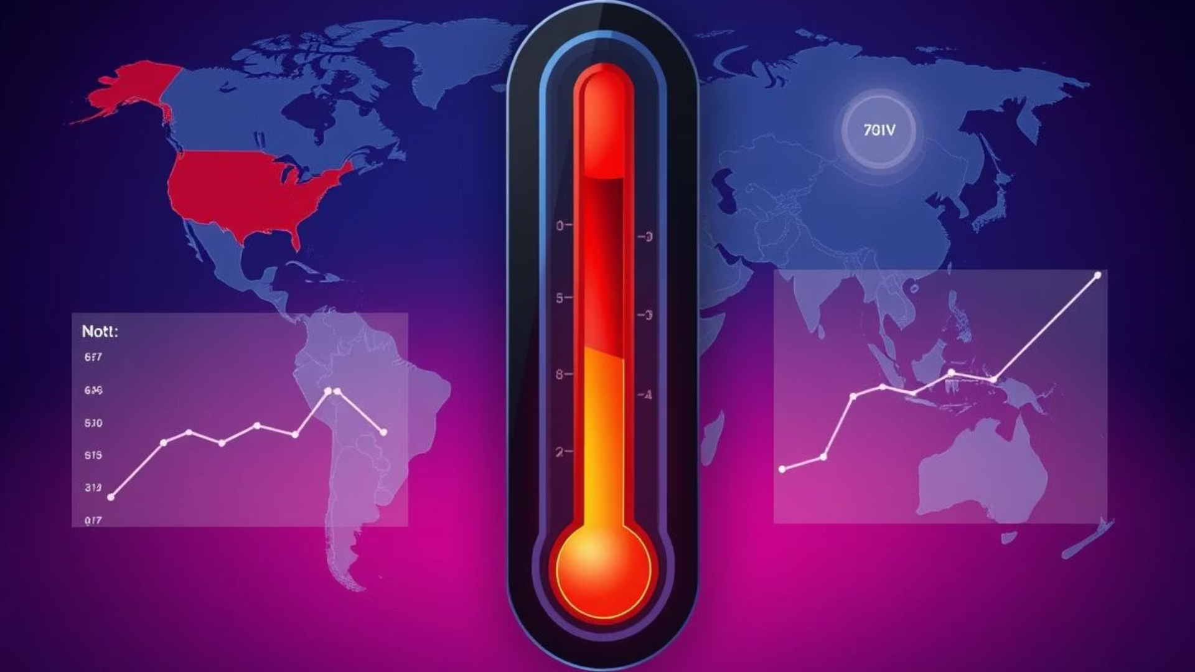
Expected Impact & Evaluation Metrics
Understand extreme temperature behavior
Predictive insights for planning
Gain detailed insights into the frequency, duration, and intensity of temperature extremes across various regions and time periods, enabling better comprehension of climate dynamics.
Provide accurate forecasts of extreme temperature events to support decision-making and risk management for communities, policymakers, and industries affected by climate variability.
Metrics: RMSE, MAE, F1-score, significance tests
Geographical robustness
Ensure that the models and analyses perform consistently across diverse geographic areas, accounting for local climatic differences and spatial variability to maximize applicability and trustworthiness.
Utilize a comprehensive set of evaluation metrics, including Root Mean Square Error, Mean Absolute Error, F1-score for classification accuracy, and statistical significance tests to ensure model reliability and performance.

Slide 12
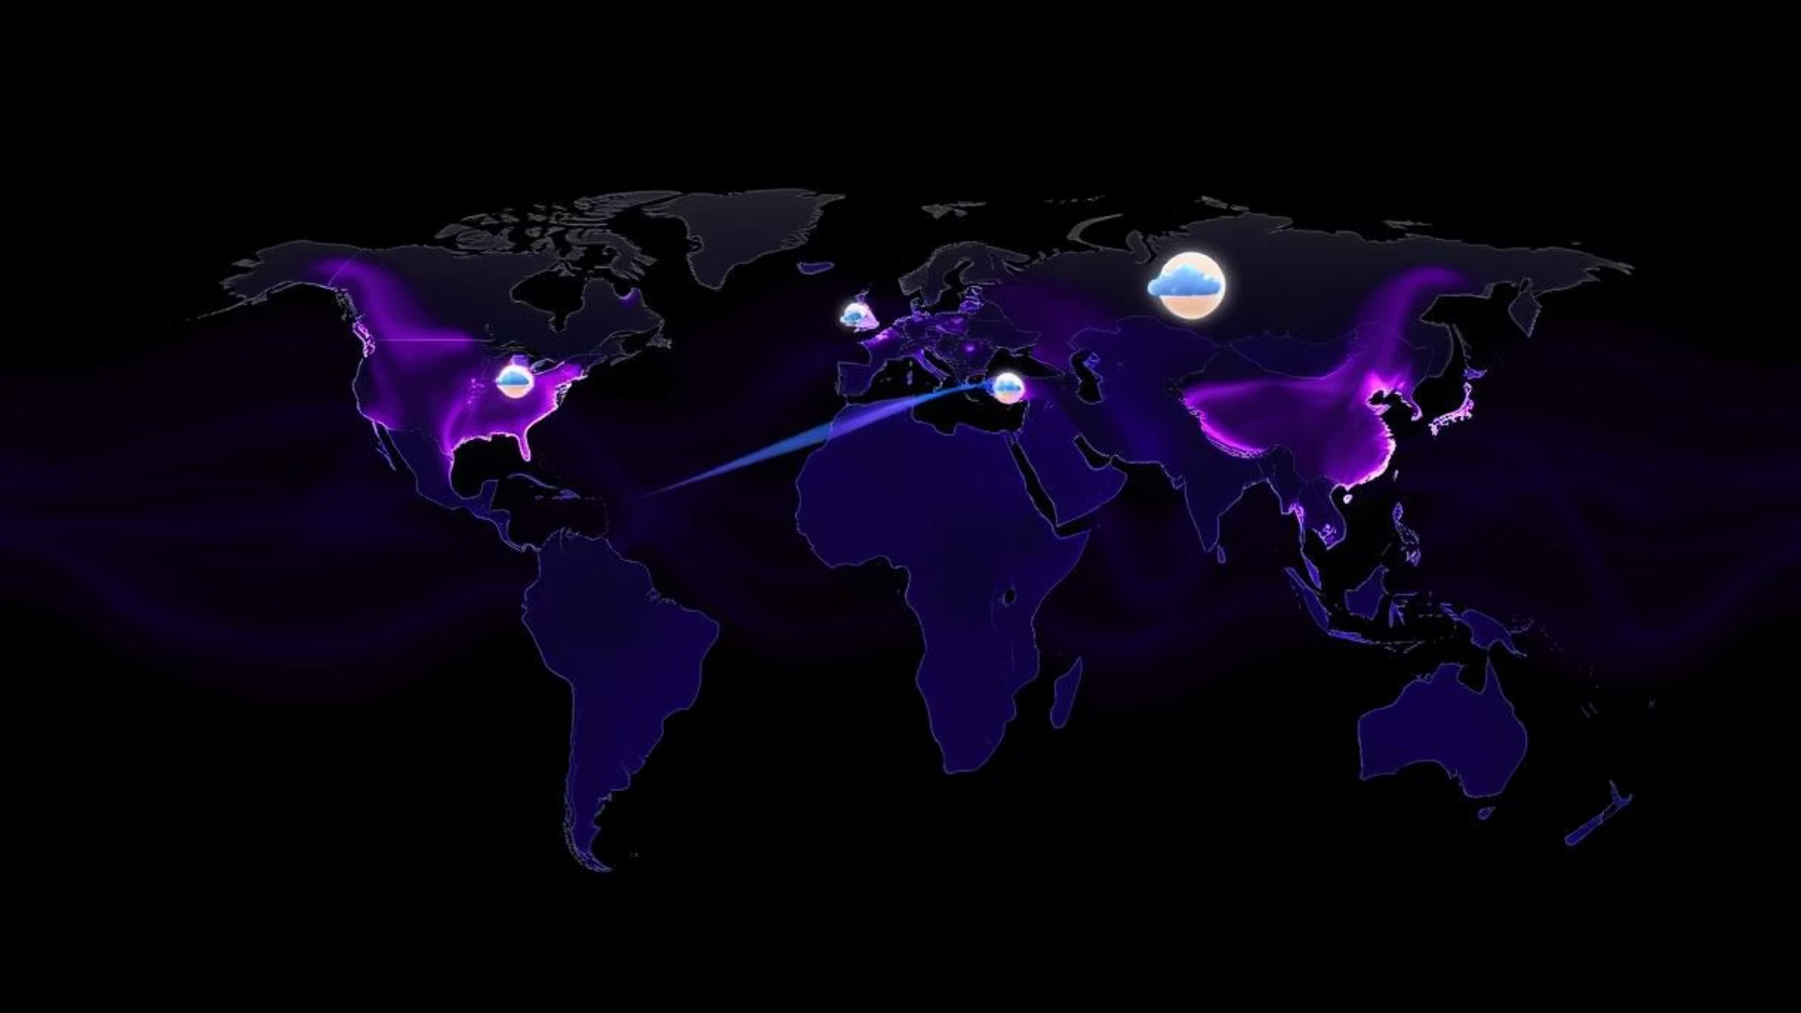


Future Extensions
Integrate climate projections:
1
Incorporate future climate models to anticipate temperature extremes under different scenarios.
Analyze socioeconomic impacts:
Study how hot and cold days affect health, agriculture, and energy demand across communities.
Early warning systems:
3
Develop proactive alerts to help stakeholders prepare for upcoming extreme temperature events.
Expand to other extreme weather:
Extend analysis to storms, floods, and droughts to broaden climate risk understanding.
Public-facing awareness tools:
5
Create user-friendly platforms to inform and engage the public on extreme temperature risks.

Slide 13

Team Members
Ritik (23SCSE1012674)
Mayank (23SCSE1012330)
Anutosh (23SCSE1012697)
Himanshu (23SCSE1012451)

